Slide 1
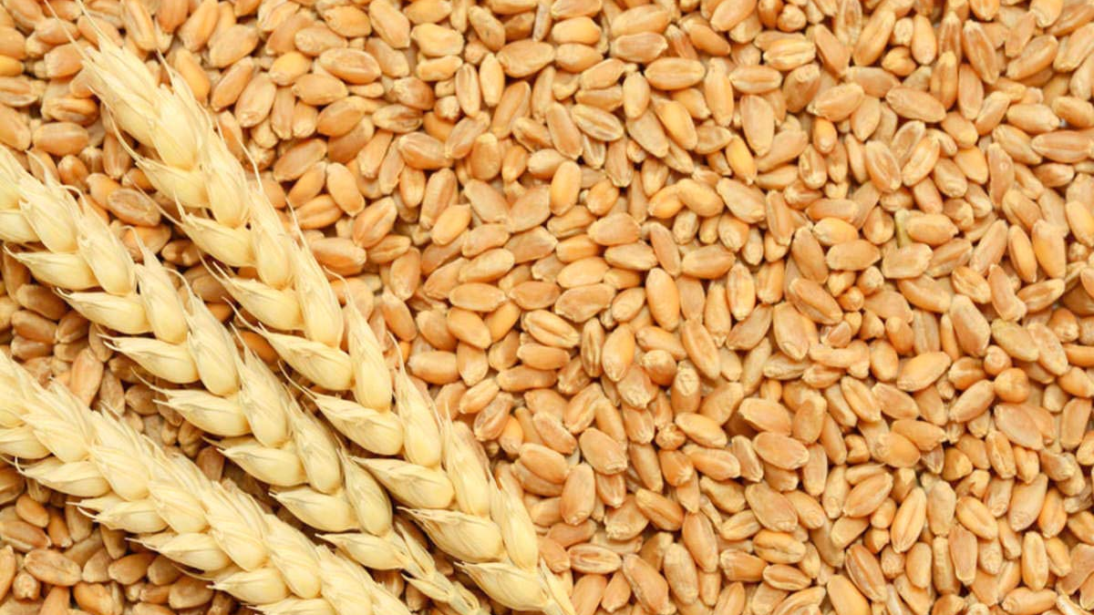
Home Assignment 2

Slide 2
Assignment Objective
Submit a report analyzing the “Wheat-Seeds” dataset using two classifier models you’ve built.
You need to classify the ‘Type’ of the seed.
The focus of the report should be performance of the two algorithms, improving them and how they compare to each other.
You can choose any two algorithms we discussed so far in the course (KNN, DT, RF) or ones that we were not yet covered in the practices.
Your conclusion should include a summary of what you did, which model is better and which hyperparameters you recommend.

Slide 3
Further Instructions
Due in 3 weeks (by Tuesday, 24/05/21), no extensions will be given.
Submit to the Moodle - the same student that submitted the first assignment.
include all group members and ID numbers.
Submit a PDF file (like the first assignment).

Slide 4
What MUST be included in the report
Essential free text (introduction, conclusion, your own comments on every graph you add and on your most important findings).
Remember! The person reading your report is not necessarily familiar with your data.
Your PDF should include code cells, but hide cell outputs that aren’t useful for the report.
Basic Data Analysis (to get familiar with your data).
At least 4 graphs, one of which must be to visualize the performance of the algorithms.
A clear and readable report using the R markdown format.

Slide 5
Hints and tips
Practice 6 has everything you need to complete the assignment (except for the different algorithms, discussed in previous lessons).
https://www.tidymodels.org/ has very good explanations on how to train and evaluate models with R.
The data is in a CSV file in the Moodle.

Slide 6
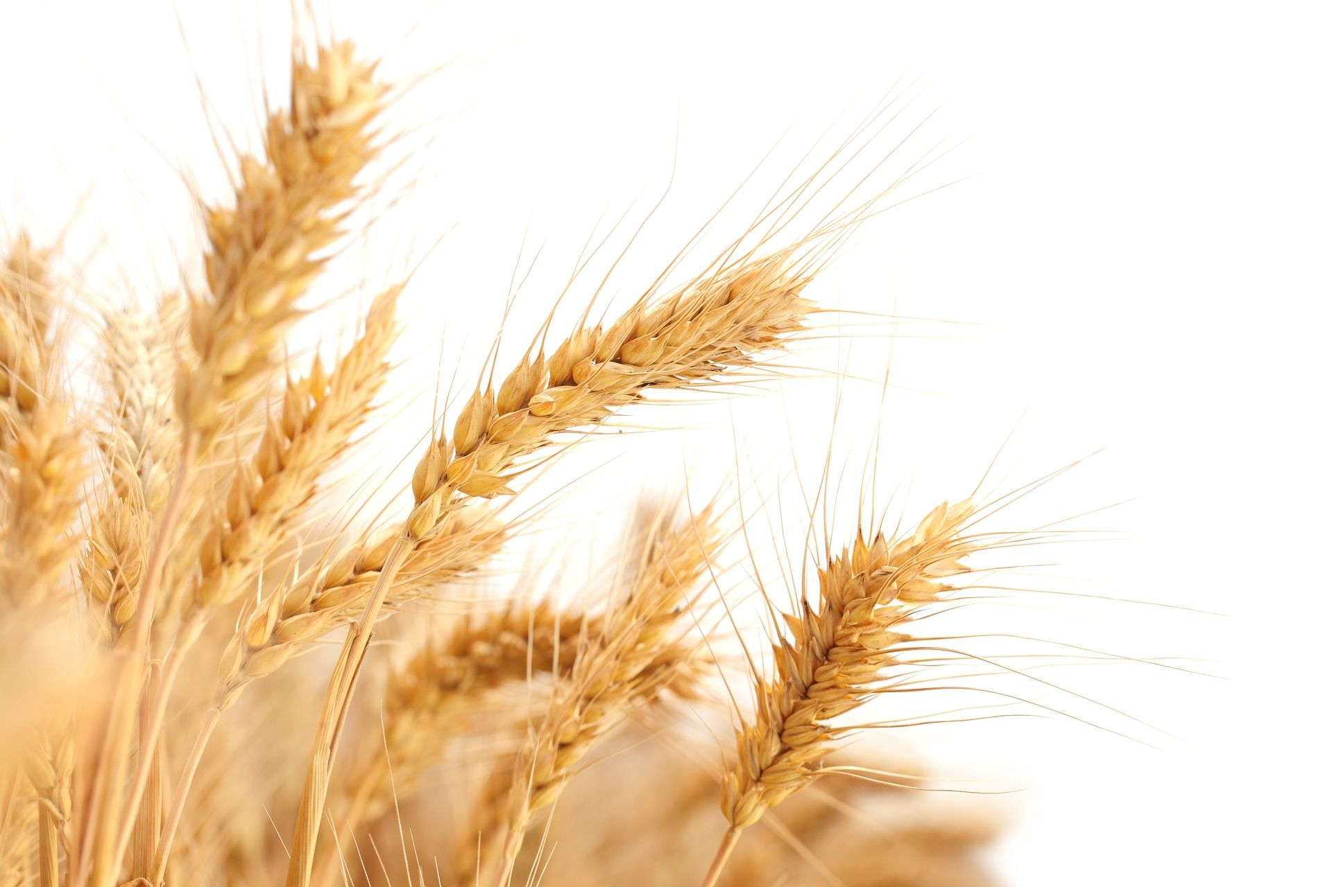
Good luck!
Good Luck!

